Slide 1
Naming Convention

Slide 2
Why Important
In C++, naming conventions are not enforced by the language itself.
There are widely accepted practices that are followed by most C++ developers to maintain:
Consistency
Readability
Maintainability.

Slide 3
Variables
Convention: camelCase or snake_case
Description:
camelCase: The first letter is lowercase, and the first letter of each subsequent word is capitalized.
snake_case: All letters are lowercase, and words are separated by underscores.
Examples:
int userAge; // camelCase
float total_price; // snake_case

Slide 4
Classes and Structs
Convention: PascalCase
Description: The first letter of each word is capitalized. This convention is also known as UpperCamelCase.
Examples
class AccountManager {
// class definition
};
struct Point3D {
// struct definition
};

Slide 5
Member Variables (Instance Variables)
Convention: mCamelCase or _snake_case
Description:
mCamelCase: Prefix with m followed by camelCase. The m stands for "member.“
_snake_case: Prefix with an underscore and use snake_case.
Examples
class Account {
int mAccountNumber; // mCamelCase
double _balance; // _snake_case
};

Slide 6
Global Variables and Constants
Convention: SCREAMING_SNAKE_CASE
Description: All uppercase letters with words separated by underscores.
Examples
const int MAX_BUFFER_SIZE = 1024;
extern float PI = 3.14159;

Slide 7
Functions
Convention: camelCase
Description: The first letter is lowercase, and the first letter of each subsequent word is capitalized.
Examples
void calculateTotalPrice();
int getUserAge();

Slide 8
Enumerations
Convention:
Enumeration type: PascalCase
Enumeration values: SCREAMING_SNAKE_CASE
Examples
enum class Color {
RED,
GREEN,
BLUE
};
enum Status {
SUCCESS,
FAILURE,
PENDING
};

Slide 9
Private and Protected Members
Convention: Prefix with an underscore or m for members
Description: An underscore or m is used to distinguish private or protected members from public members.
Examples
class MyClass {
private:
int _privateVariable;
int mPrivateVariable;
protected:
int _protectedVariable;
public:
int publicVariable;
};

Slide 10

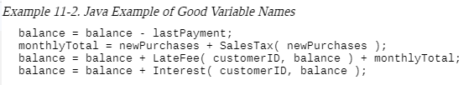
Considerations in Choosing Good Names
EXAMPLE OF POOR VARIABLE NAMES
What's happening in this piece of code?
What do x1, xx, and xxx mean?
What does fido mean?
Suppose someone told you that the code computed a total customer bill based on an outstanding balance and a new set of purchases. Which variable would you use to print the customer's bill for just the new set of purchases?

Slide 11
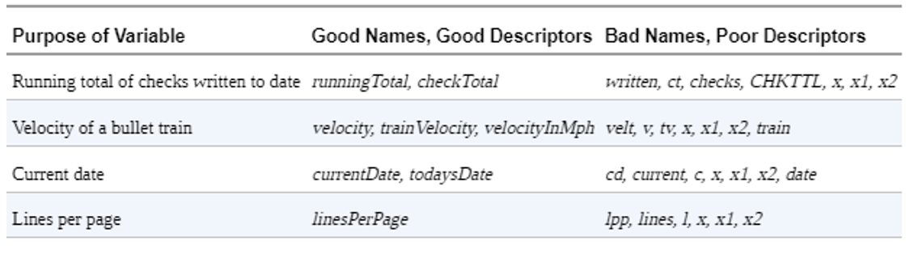
Important Naming Consideration
The name should fully and accurately describe the entity the variable represents.
An effective technique is to state in words what the variable represents.
It's easy to read because it doesn't contain cryptic abbreviations, and it's unambiguous.
It won't be confused with something else.
It's easy to remember because the name is similar to the concept.

Slide 12
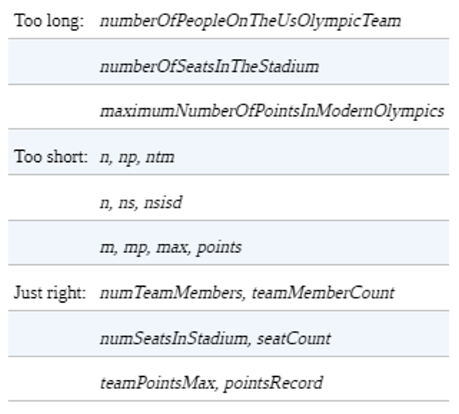
Optimum Name Length
Names that are too short don't convey enough meaning. The problem with names like x1 and x2 is that even if you can discover what x is, you won't know anything about the relationship between x1 and x2.
Names that are too long are hard to type and can obscure the visual structure of a program. For example: maximumNumberOfPointsInModernOlympics
Studies found that the effort required to debug a program was minimized when variables had names that averaged 10 to 16 characters
Are short variable names always bad? No, not always. When you give a variable a short name like i, the length itself indicates that it is used for a limited scope of operation.

